Slide 1
Basic TouchDesigner Workshop
Creative Coding Utrecht
Raul Leal (Digital Piglet) ｜ 21. 09. 2024

Slide 2





Slide 3
WIFI: ccu
WW: Code03084

Slide 4
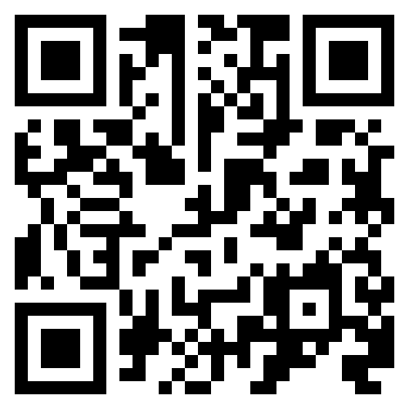
Discord
https://discord.gg/gP4c43Yg

Slide 5
Hi my name
Is Raul Leal

Slide 6
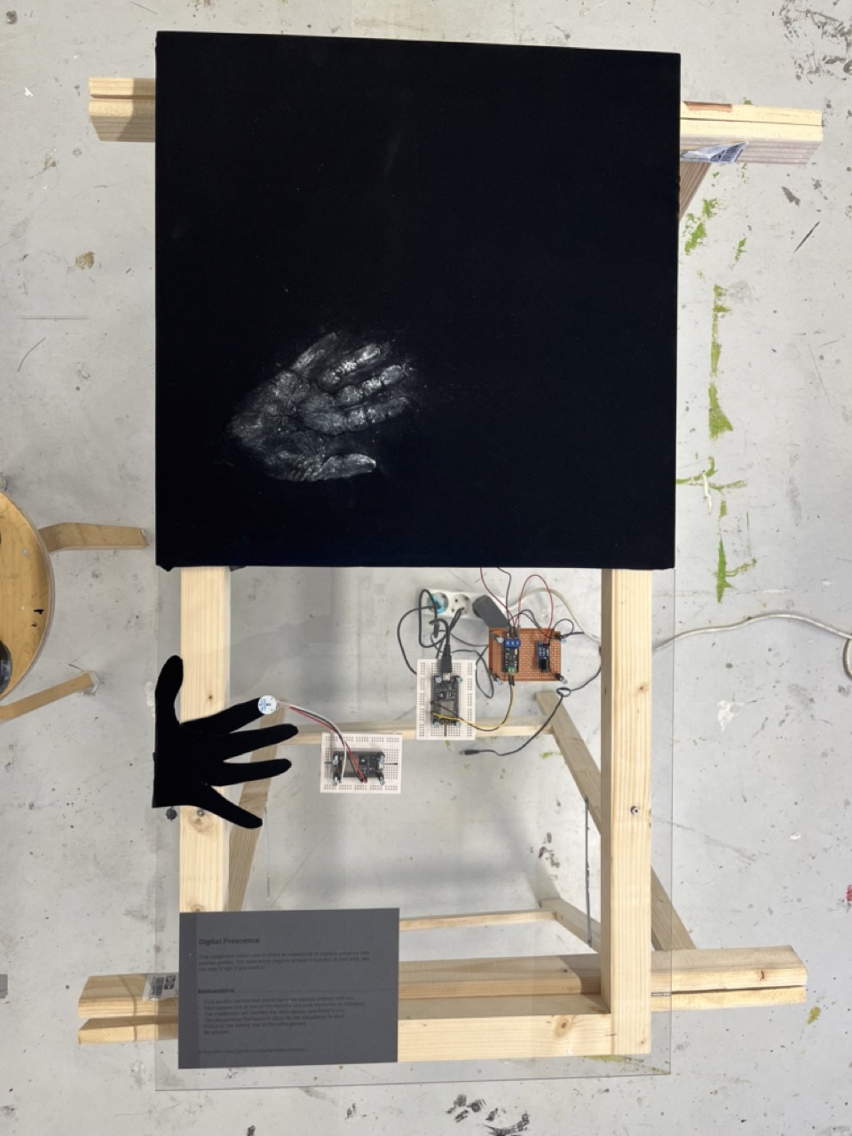
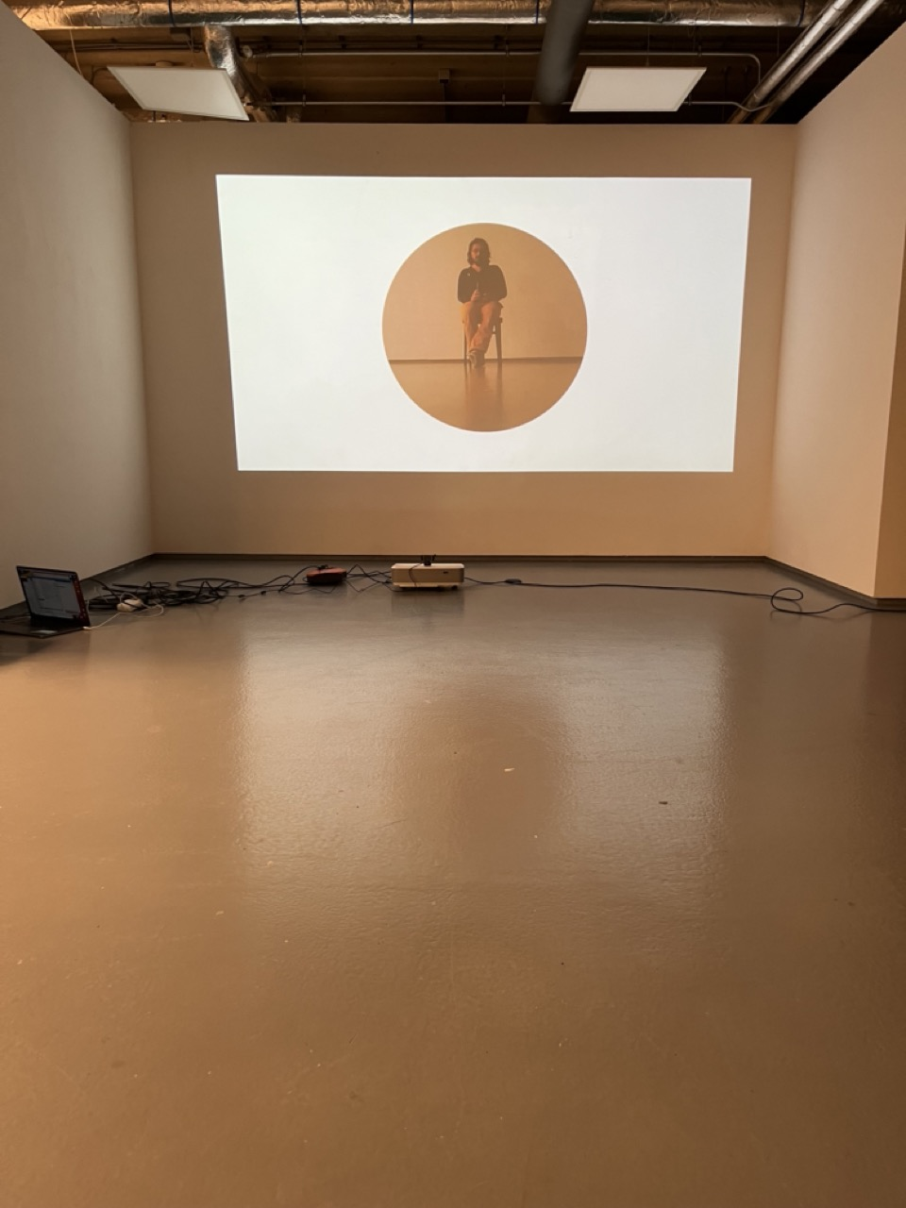
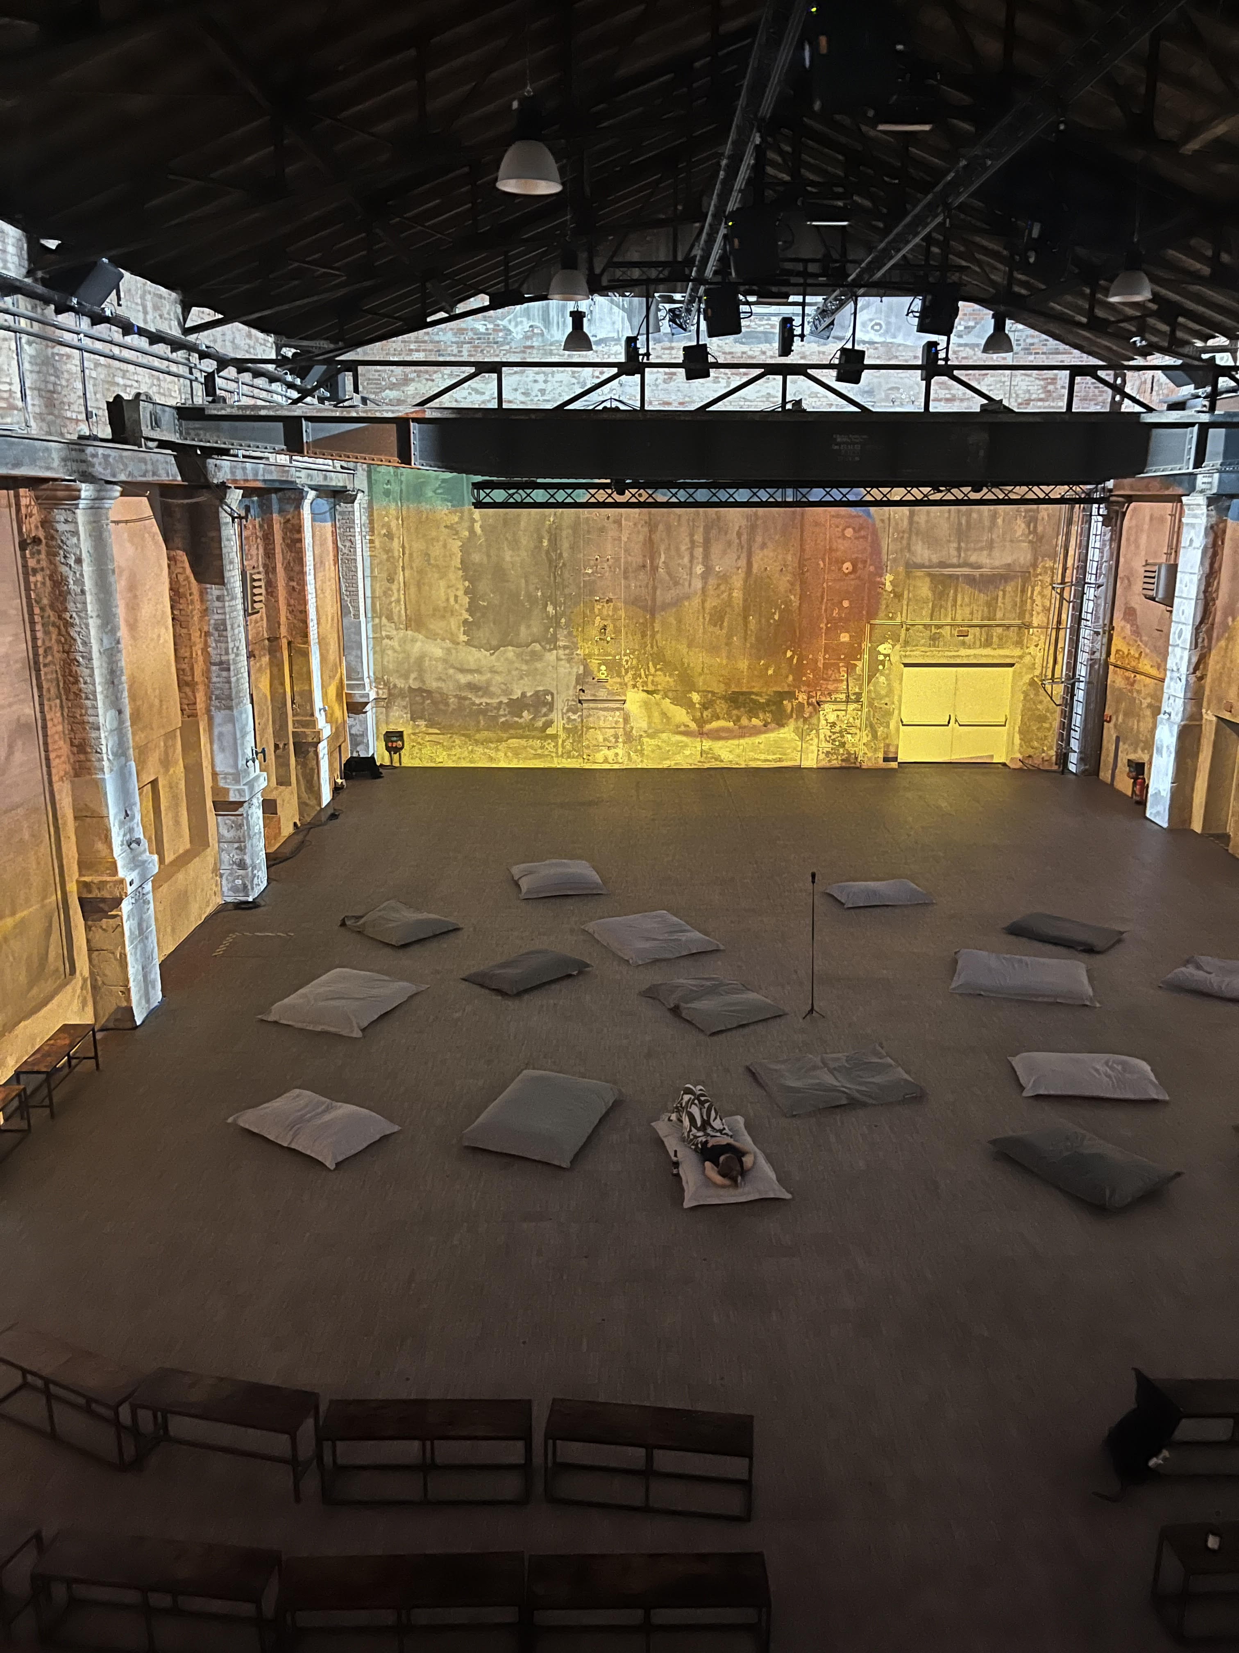
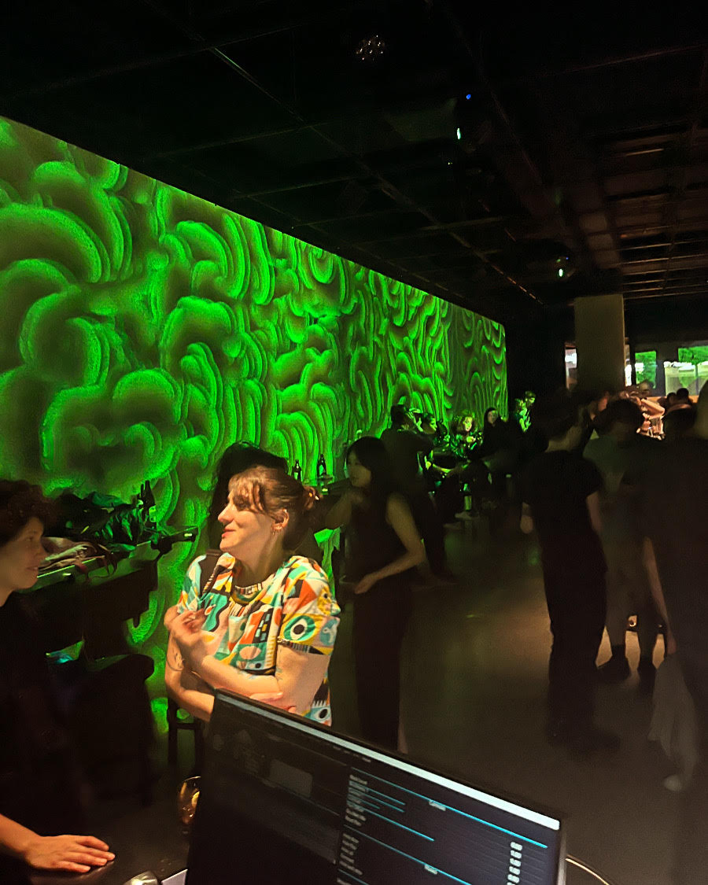
Me
Creative technologist
Rietveld Academy – DogTime Unstable Media
In my practice I aim to use technology as a companion for creation instead of simply as a tool

Slide 7
This workshop
What we will do!
What we will not do
Basic Introduction
  Programming with TD
  Common useful logic patterns
  Assigning references
Bauhaus motion graphics
Have fun
No 3D
No Particles
No Kinect

Slide 8
No 3D
No Particles
No Kinect

Slide 9
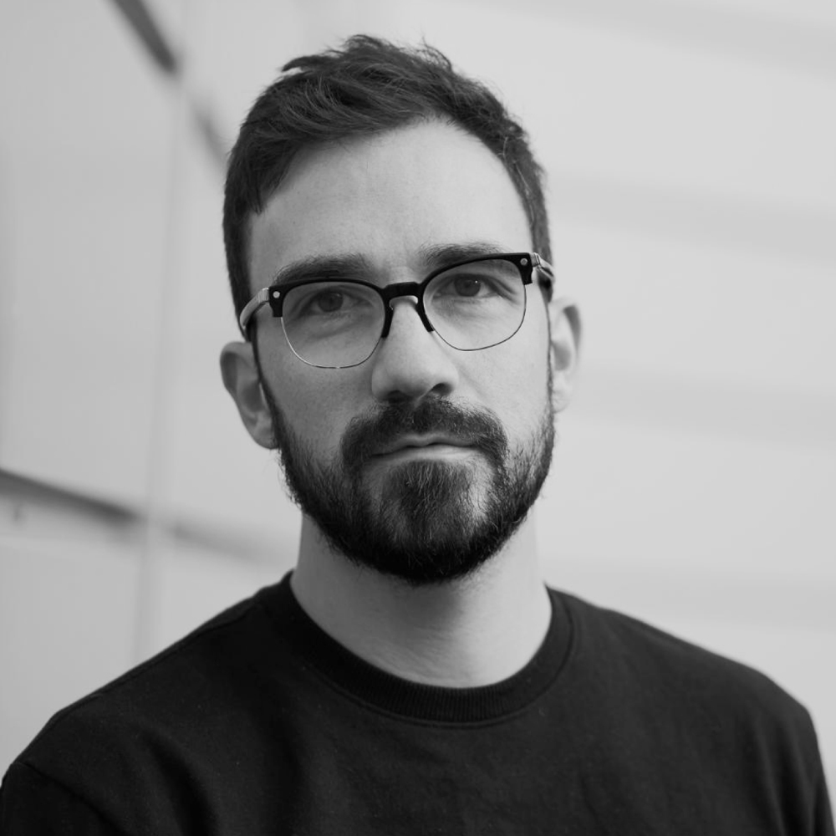
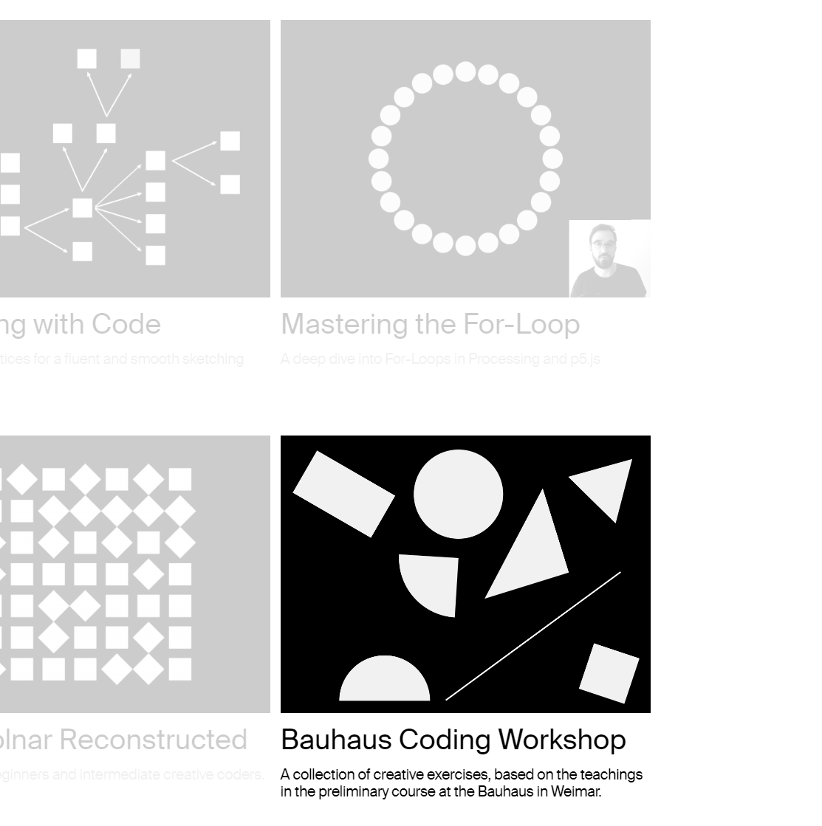
Tim Rodenbröker

Slide 10
Constraints for the workshops…
It is done in
TochDesigner and...
Only uses...
Only uses...
It is an interactive 2d animation,
i.e. no 3d scenes, objects etc..

Slide 11

Workshop Structure
Intro
Draw things
Make them move
Add logic to the movement
Make them audio reactive

Slide 12
Two main principles…
TouchDesigner is a programming language…
…It requires a “different” mindset

Slide 13
In a nutshell…
Node based programming language
  Essentially function composition f(g(h(x)))
Very good for making data into visuals (not scientific)
Very good for sensor data and sending it back to devices
Not good at making sound – go to Ableton or Max
  Good to orchestrate midis though

Slide 14
Let’s Begin!

Slide 15
Discord
https://discord.gg/gP4c43Yg

Slide 16
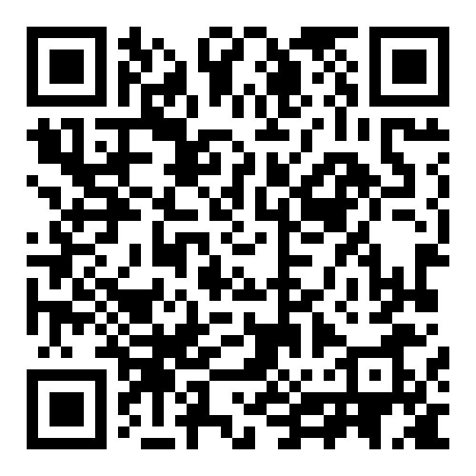
Git repository
https://github.com/Rauleal/TouchDesigner_Bauhaus_workshop

Slide 17
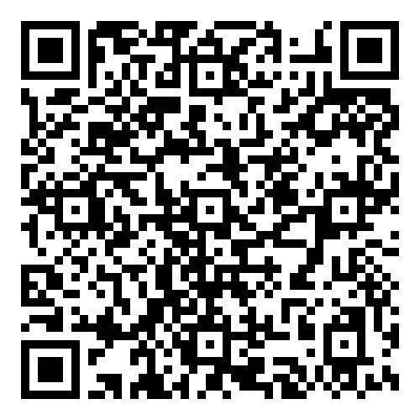
YouTube channel
https://www.youtube.com/watch?v=AMGkNHyQ4o0&list=PL3zGSOEHGdiR5x5BIg8E8yn2BQMbQ6igb

Slide 18
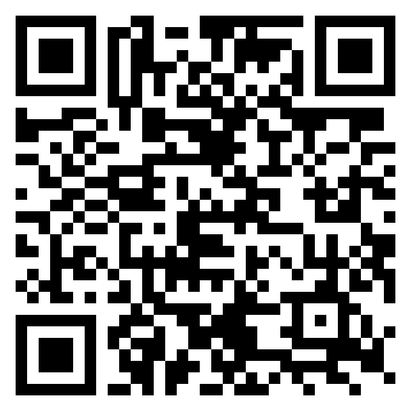
TouchDesigner
Documentation
https://docs.derivative.ca/Main_Page

Slide 19
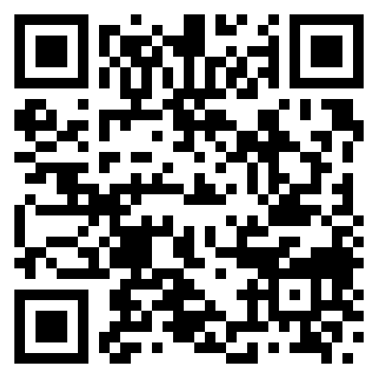
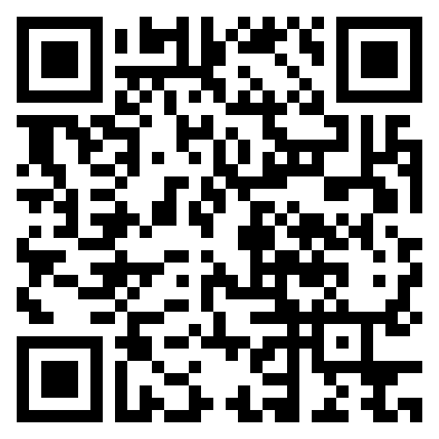
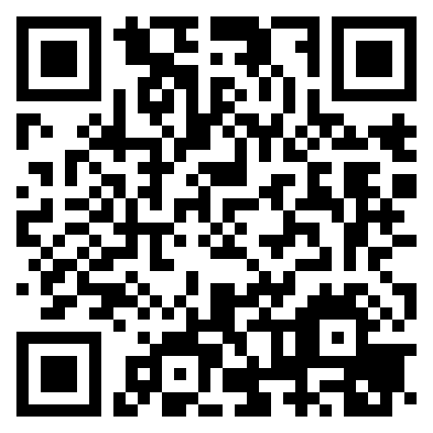
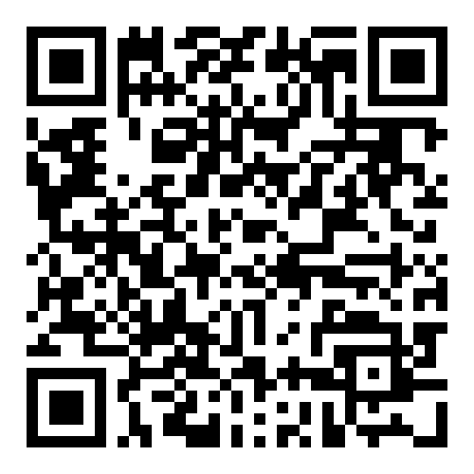
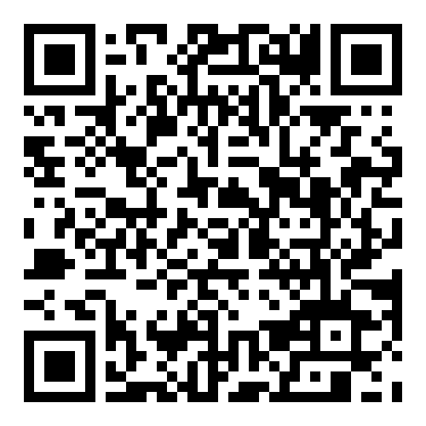
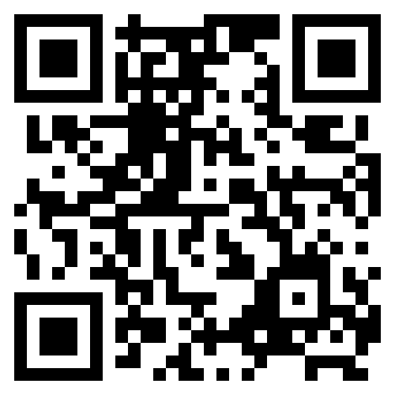
Interesting Artist/tutorials
Elekktronaut
Paketa12
Noto the talking ball
The Interactive Immersive HQ
Derivative fundamentals
Node Institute

Slide 20
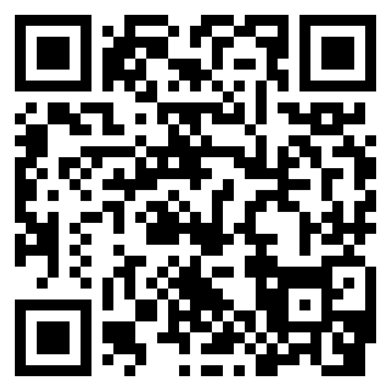
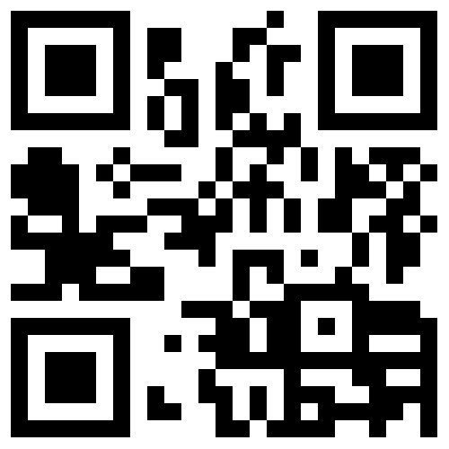
Email_to:
raul.andres.leal@gmail.com
https://www.instagram.com/raul.andres.leal/
https://rauleal.com/

Slide 21
Coming up
Utrecht CCU
  25th April TouchDesigner meetup
Berlin
  22-23 May – European TouchDesigner event- Also online
Amsterdam
  28 May – TouchDesigner meet up (Amaze/y=f(x))
Online
  NODE institute - Summer sessions 2024

Slide 22
Thanks !

